Slide 1

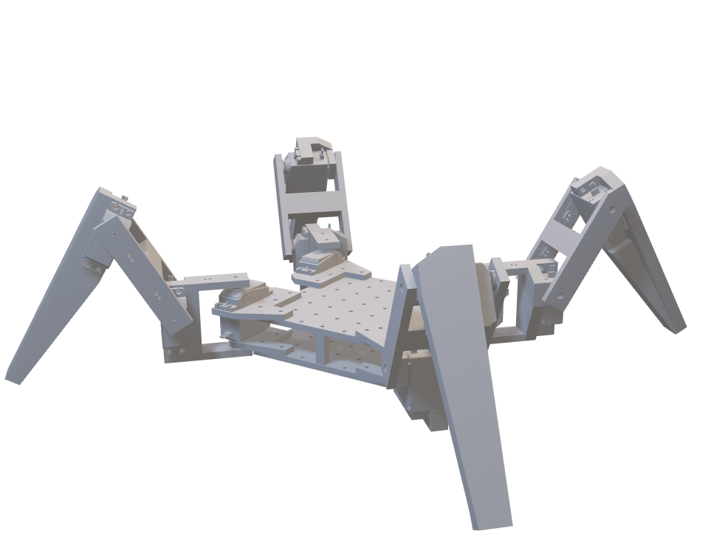
JeevI: Deep Reinforcement Learning Robot
Presenters: Ashish Gupta, Rubina Dangol Maharjan
Supervisors: Manoj Shakya, Sandesh Thakuri
Semester Project: AISP 311
Department of Artificial Intelligence, Kathmandu University

Slide 2
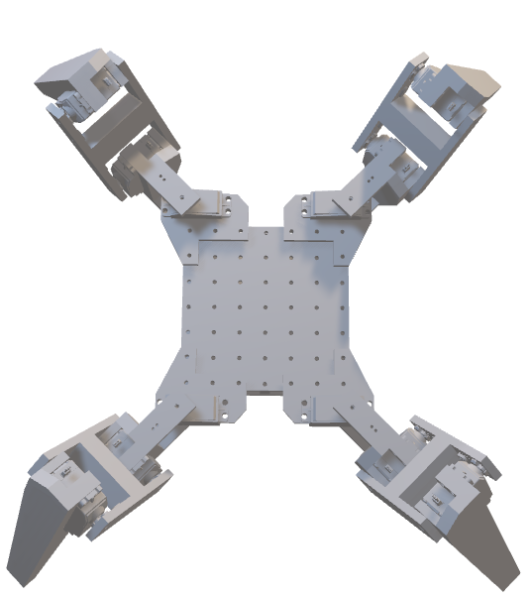
Outlines
02
01
Problem Statement
Introduction
03
04
Objectives
Methodology
Core Challenges Addressed
Project Overview & Background
Defined Goals & Targets
Design & Implementation Approach

Slide 3
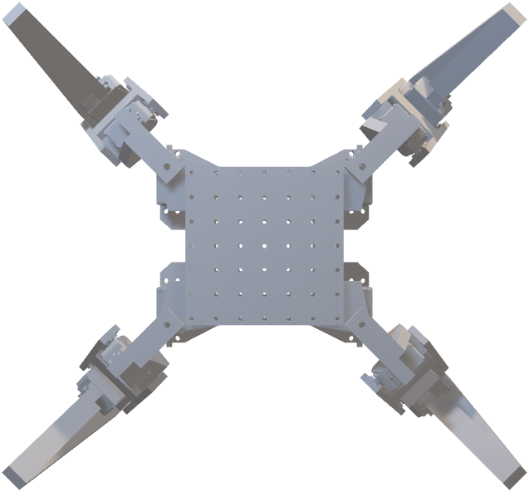
Outlines
06
05
Improvements
Results
07
08
Challenges
Conclusion
Future Enhancements
Performance Outcomes Achieved
Difficulties Encountered
Key Findings & Contributions

Slide 4
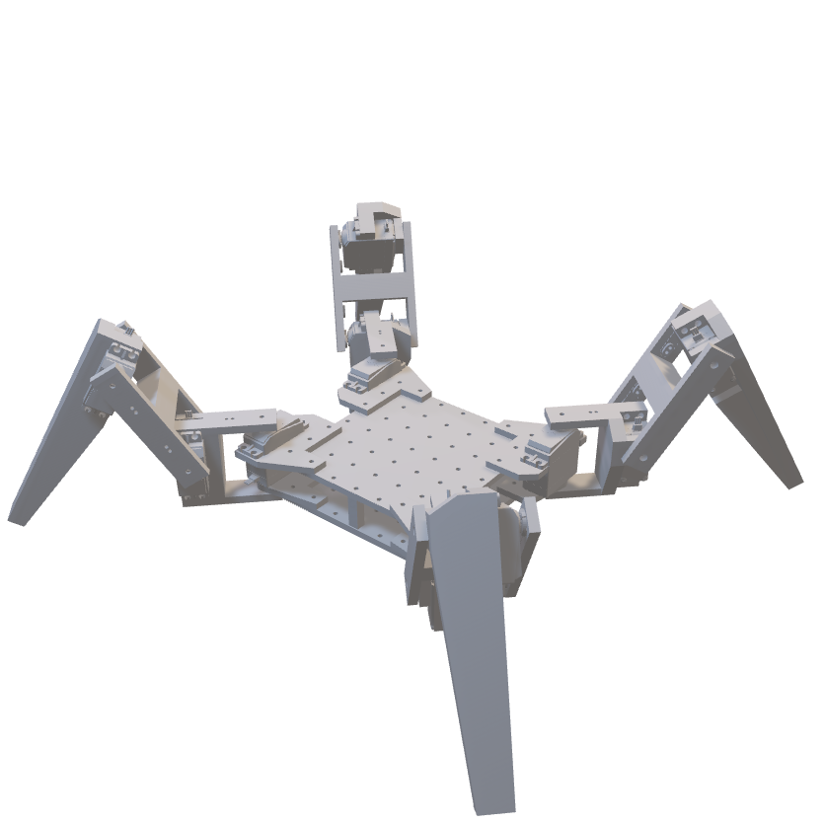
Introduction
JeevI is a simulation-based quadrupedal robot developed to achieve robust locomotion in complex disaster-like terrains using Deep Reinforcement Learning.
Designed and trained using NVIDIA Isaac Lab
Locomotion Policy trained using Proximal Policy Optimization (PPO)
Progressive training strategy: Flat → Rough → Box Terrain
Successful Transfer Learning across increasingly complex environments

Slide 5
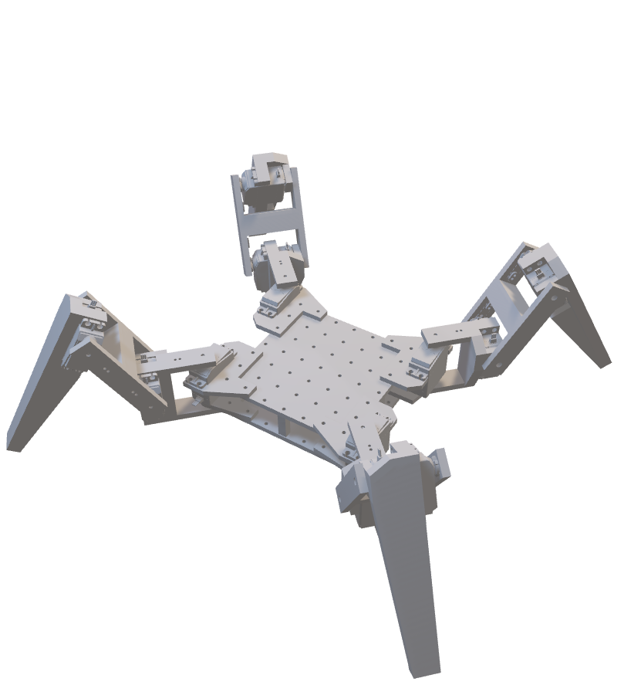
Problem Statement
Inaccessibility of Disaster Zones
Limitations of Existing Mobility Systems
Lack of Robust Autonomous Locomotion
Need for Simulation-First Development
Disasters create unstructured terrain that is difficult to access.
Wheeled and tracked robots struggle on rubble and uneven surfaces.
Stable quadrupedal locomotion in irregular terrain remains a challenging control problem.
Training directly on physical robots is costly and risky.

Slide 6
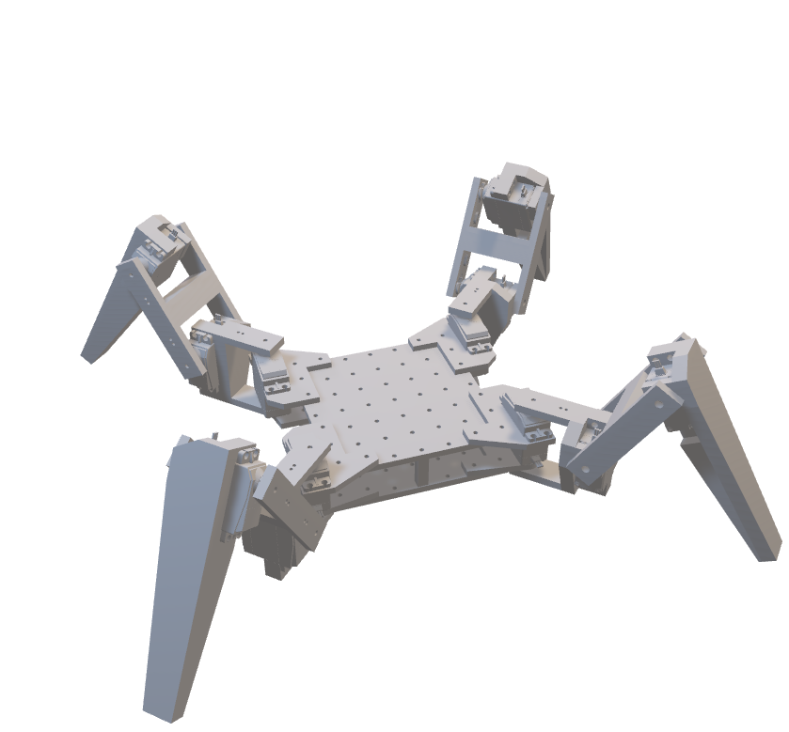
Objectives
Robot Design & Simulation
Locomotion Policy Training
Terrain Generalization
To design a custom 12-DOF Quadrupedal Robot and successfully integrate it into NVIDIA Isaac Sim
To train locomotion control policy using Deep Reinforcement Learning (PPO) on flat terrain.
To improve the trained locomotion policy on Rough and box Terrain

Slide 7
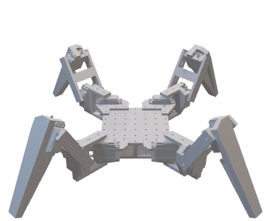
Methodology
Flat, Rough, and Box Terrain Creation, Markov Decision Process (MDP) Formulation
Reward Convergence,
Episode Length, Comparative Analysis
Design
Policy
Training
Evaluation
3D Modeling of Robot,
Integration into NVIDIA Isaac Sim
PPO Implementation, Training Robot in Different Terrain

Slide 8
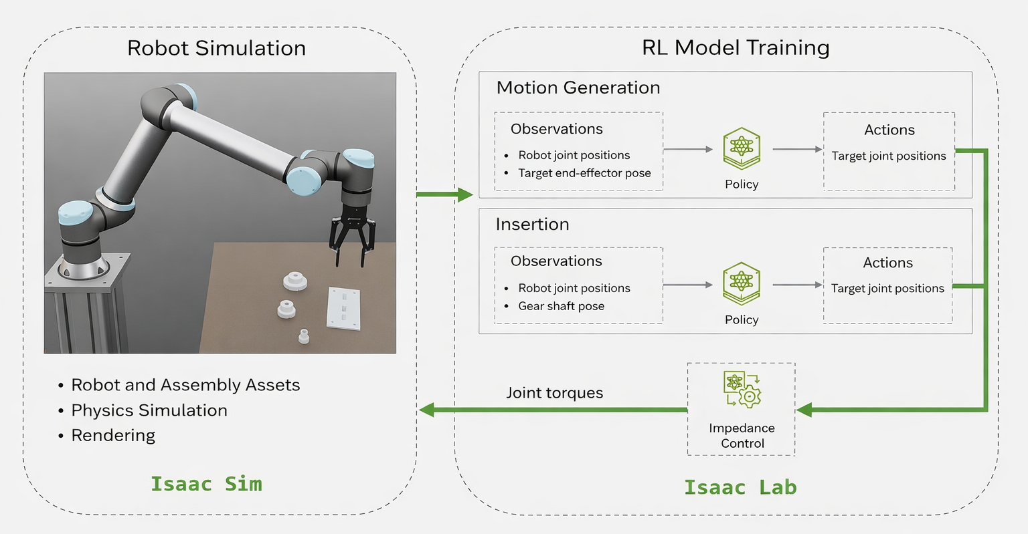
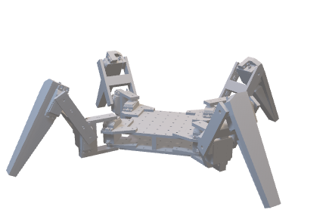
Isaac Sim & Isaac Lab
Isaac Sim
Isaac Lab
Isaac Sim is NVIDIA’s robotics simulation platform built on the Omniverse. It lets you bring robot models into a physically realistic virtual world, add physics, sensors, and environments, and interact with them just like you would in the real world.
Isaac Lab is a robot learning and training framework built on top of Isaac Sim. It adds easy-to-use reinforcement learning and skill training tools, letting you train and refine robot policies efficiently using Python APIs and GPU acceleration.

Slide 9
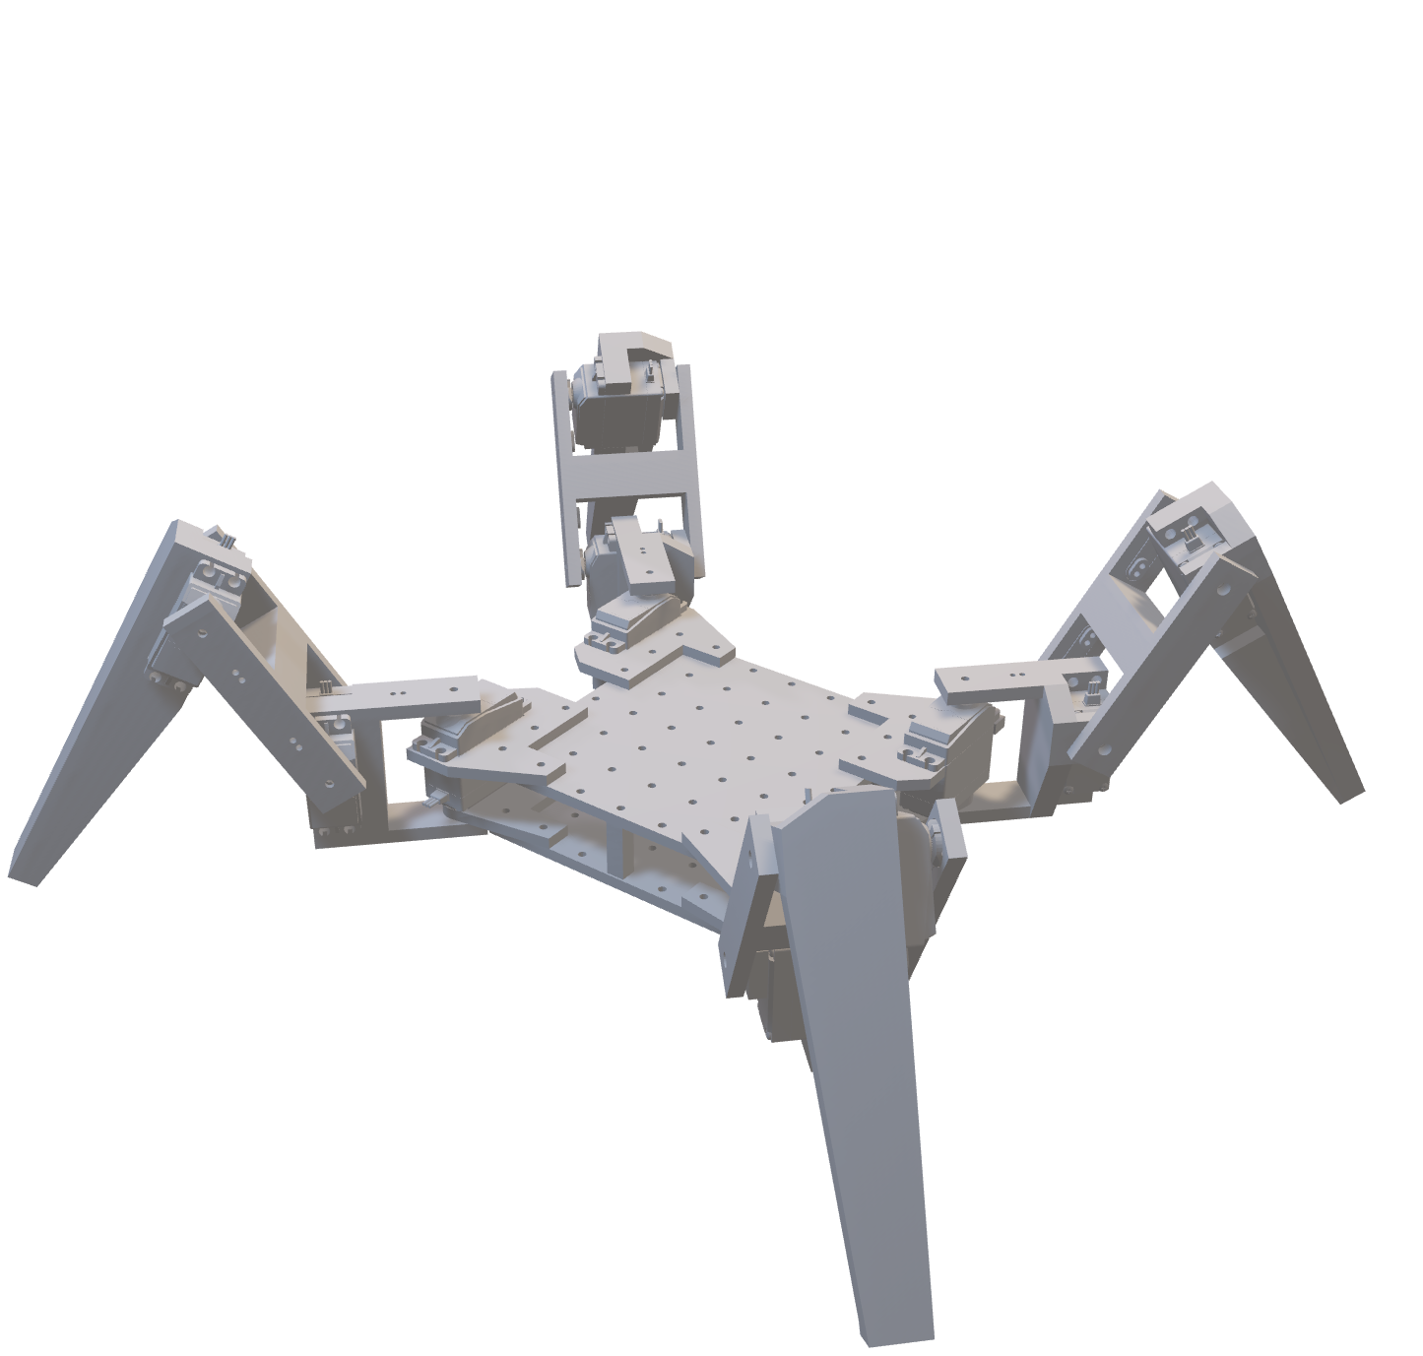
Methodology: Design
Robot Structure, Joints & Sensors
Hip Roll Joint
Rear Right Leg
Knee Joint
Rear Left Leg
Foot Contact Sensors
Front Right Leg
Inertial Measurement Unit (IMU)
Hip Pitch Joint
Main Body
Front Left Leg

Slide 10
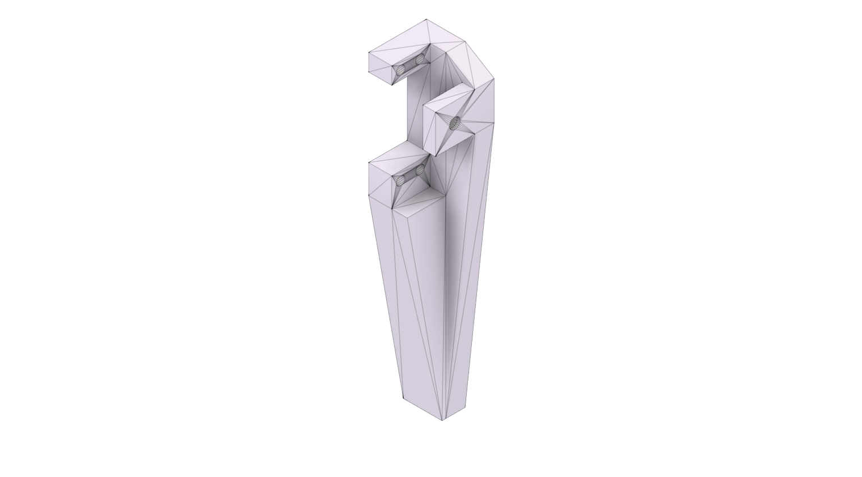
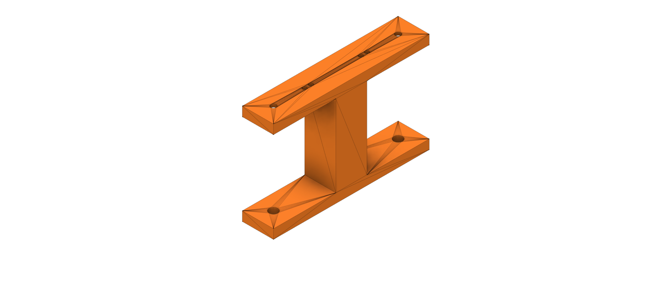
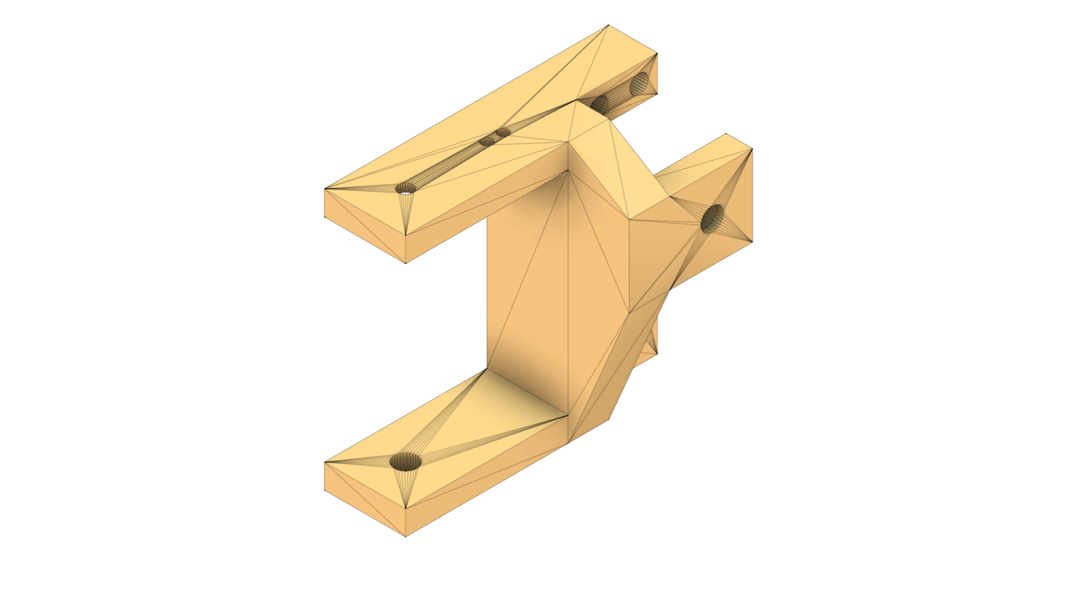
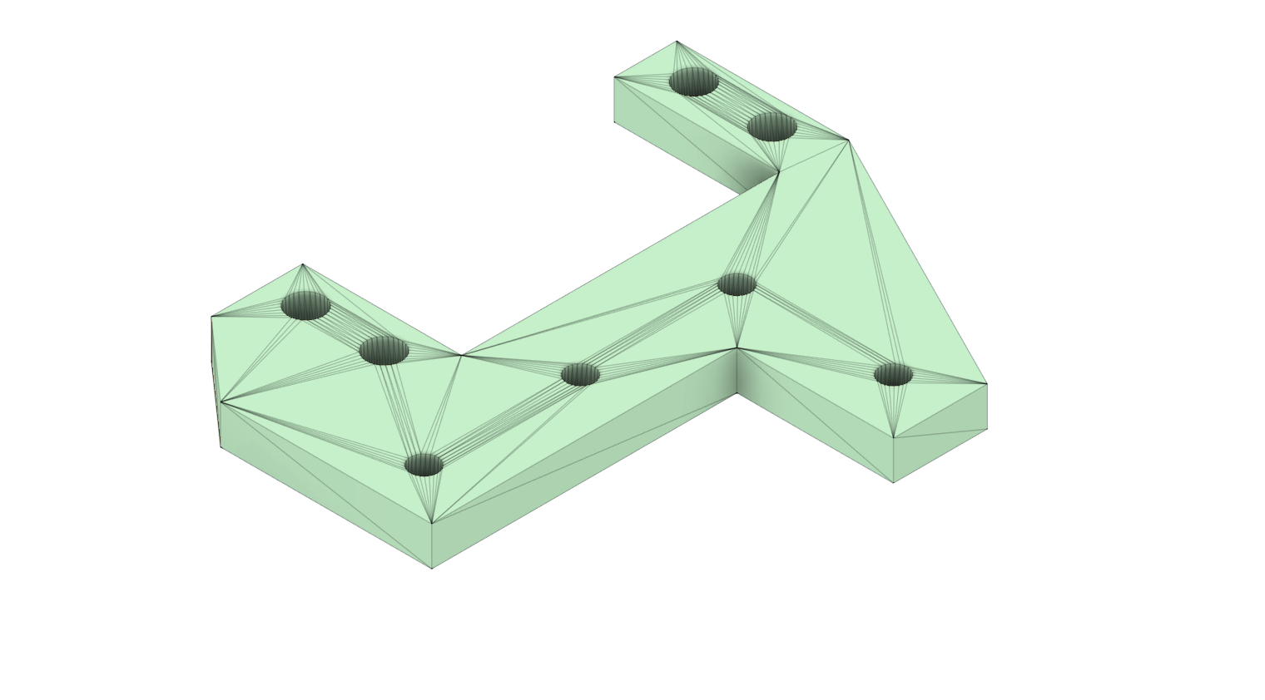
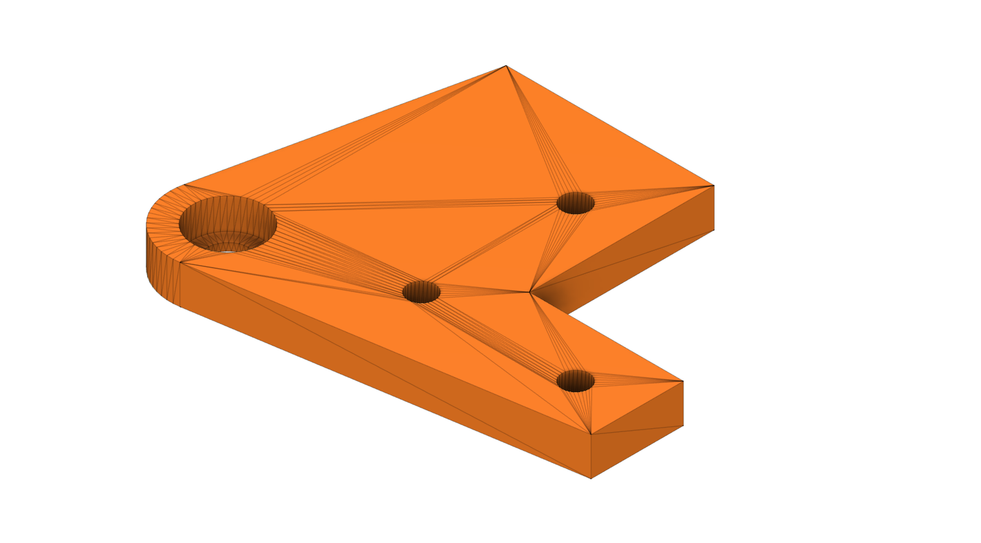
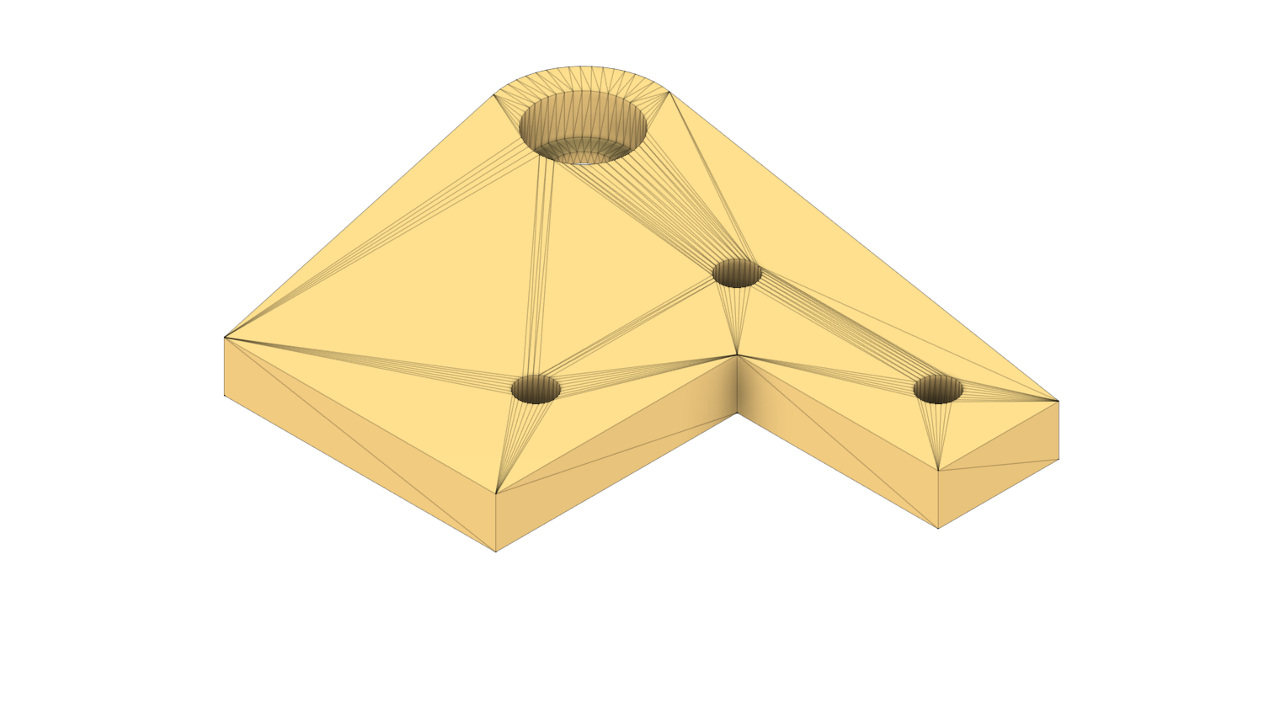
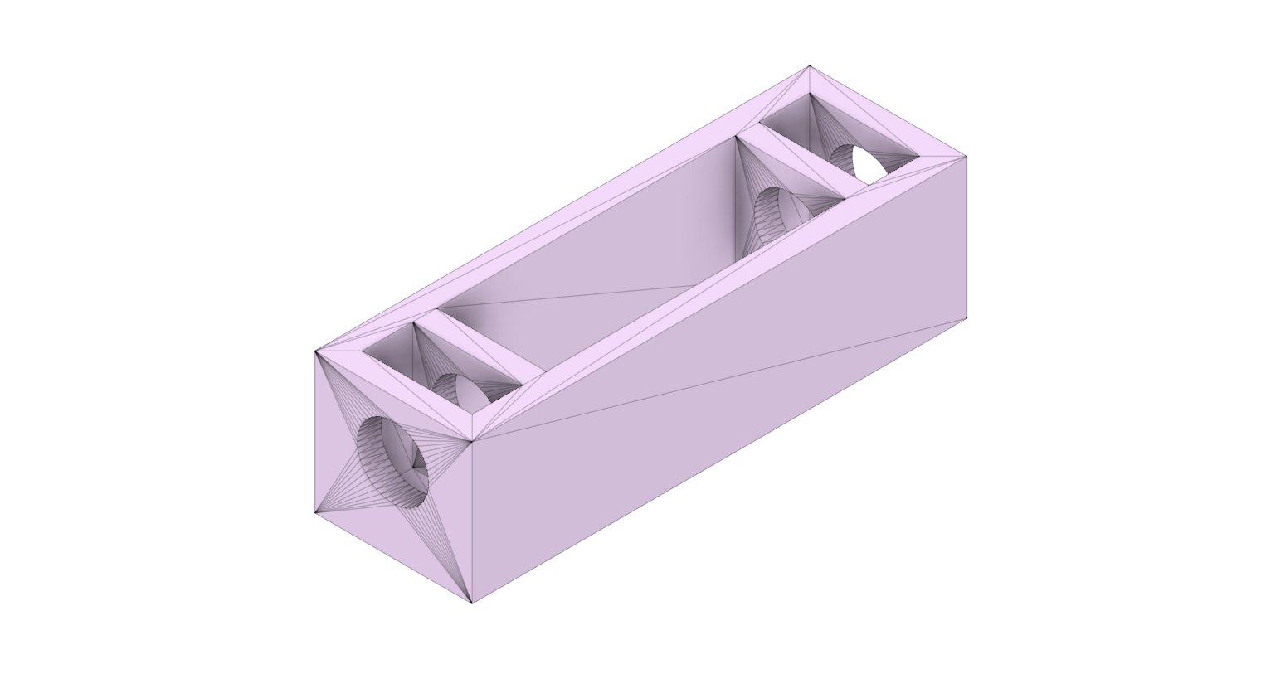
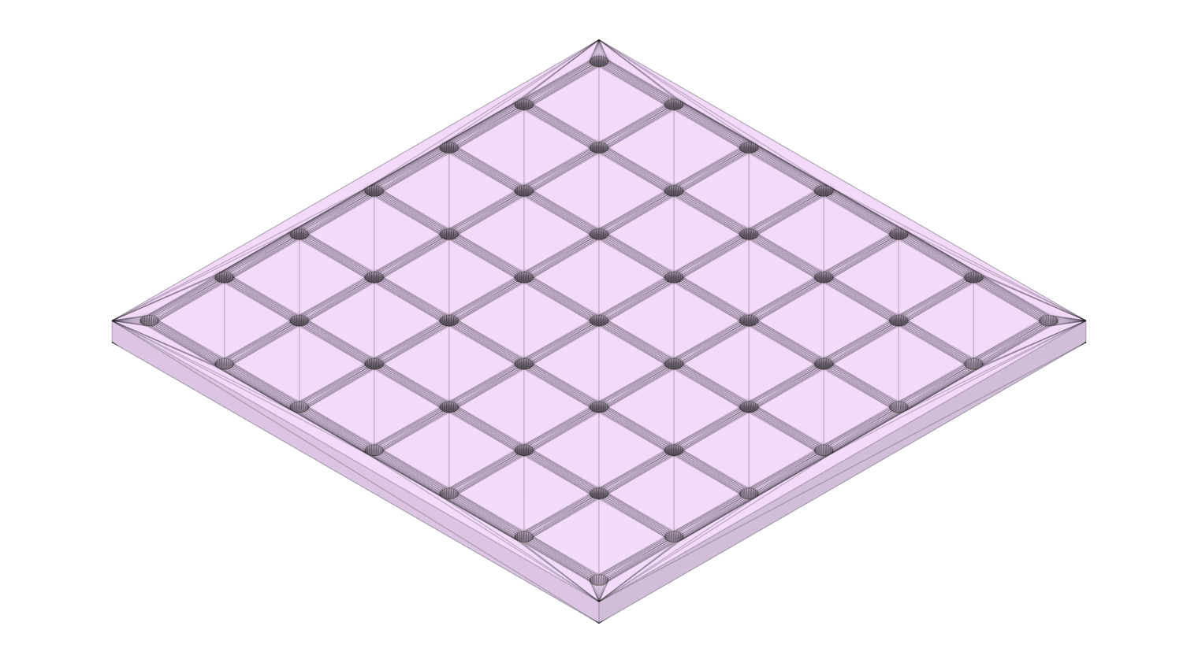
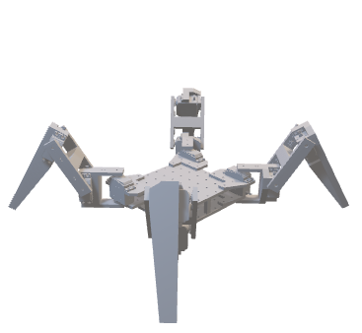
Methodology: Design
Design Steps
Designed individual mechanical components in Fusion 360
Assembled using revolute joints to form 12-DOF quadruped in Fusion 360
Exported assembled model to URDF format
Imported URDF into Isaac Sim and converted to USD Articulation
Configured Joint Drives, Stiffness, Damping, and Limits
Attached simulated sensors (IMU, Encoders, Contact Sensors)
Export Robot USD file into Isaac Lab for RL Training
Parts of JeevI Robot

Slide 11



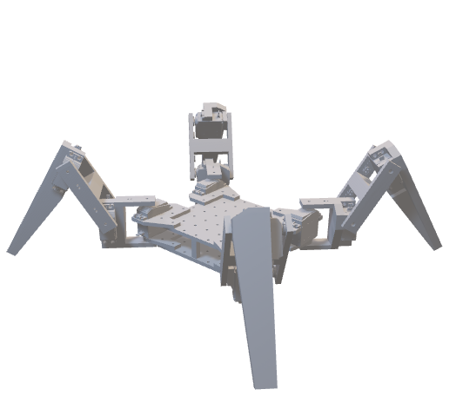
Methodology: Policy
Environment Setup
Plane Surface
- Baseline Environment
- Used for Initial Locomotion
Rough Surface
- Uneven Gravel
- Random Slope Variations
Box Surface
- Discrete Rigid Blocks
- Randomized Placement

Slide 12
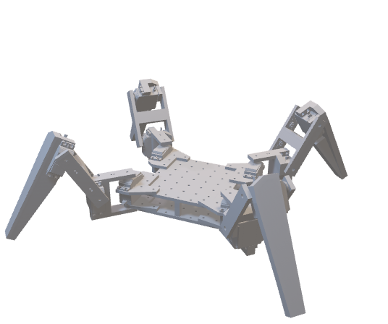
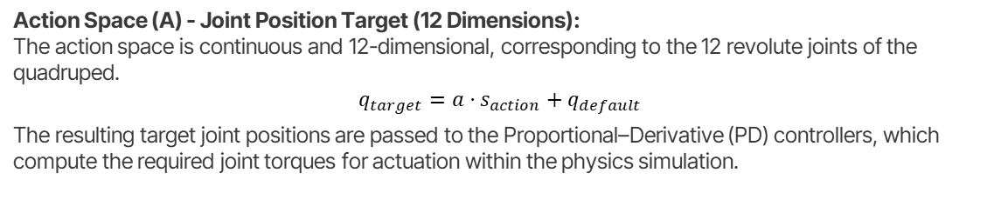
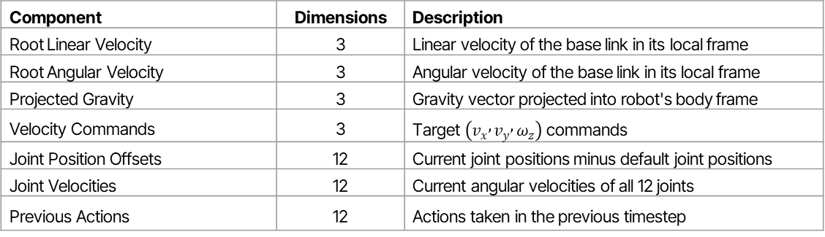
Methodology: Policy
MDP Formulation
State Space (S) - Observations (48 Dimensions)
Component | Dimensions | Description
Root Linear Velocity | 3 | Linear velocity of the base link in its local frame
Root Angular Velocity | 3 | Angular velocity of the base link in its local frame
Projected Gravity | 3 | Gravity vector projected into robot's body frame
Velocity Commands | 3 | Target $\left(v_{x} , v_{y} , ω_{z}\right)$ commands
Joint Position Offsets | 12 | Current joint positions minus default joint positions
Joint Velocities | 12 | Current angular velocities of all 12 joints
Previous Actions | 12 | Actions taken in the previous timestep
Action Space (A) - Joint Position Target (12 Dimensions):
The action space is continuous and 12-dimensional, corresponding to the 12 revolute joints of the quadruped.
$$q_{target}=a⋅s_{action}+q_{default}$$
The resulting target joint positions are passed to the Proportional–Derivative (PD) controllers, which compute the required joint torques for actuation within the physics simulation.

Slide 13
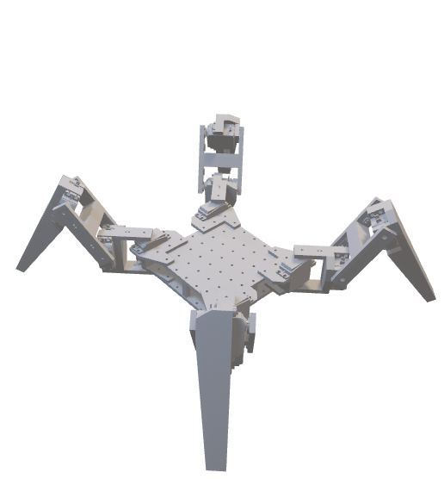
Methodology: Policy
MDP Formulation
Reward Function (R): Components
Component | Meaning
Linear Velocity Tracking | Encourages the robot to match the commanded forward speed.
Yaw Rate Tracking | Encourages the robot to match the commanded turning rate.
Z Velocity Penalty | Penalizes excessive vertical bouncing of the robot’s body.
Angular Velocity (XY) | Penalizes roll and pitch oscillations to improve balance.
Joint Torques | Penalizes high actuator effort to promote energy efficiency.
Joint Accelerations | Penalizes abrupt joint movements for smoother motion.
Action Rate | Encourages gradual action changes between timesteps.
Flat Orientation | Keeps the robot’s body upright and aligned with gravity.
Foot Contact | Ensures sufficient ground contact to prevent unstable gaits.
Foot Force Variance | Encourages proper stepping instead of dragging feet.
Base Height (Boxes Only) | Maintains body elevation when navigating obstacles.

Slide 14
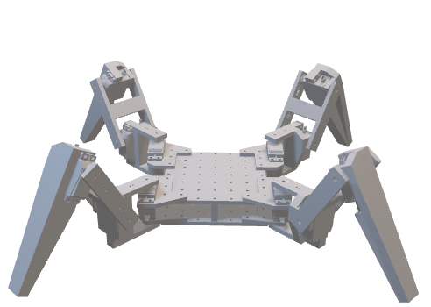
Methodology: Policy
MDP Formulation
Reward Function (R): Design Philosophy
Episode Termination Conditions
1. Time-Out
- Maximum Episode Length: 2000 Steps
- Equivalent: 40 Seconds
2. Falling Condition
Contact Forces on Hip Segments More
Indicates Body Collapse
Positive Rewards drive commanded motion and upright stability
Negative Penalties suppress unstable or unrealistic behaviors
Foot Contact term prevents tripod hopping behavior
Foot Force Variance promotes natural stepping patterns
Transition Dynamics (T)
The environment dynamics is done by the NVIDIA PhysX physics engine.
Physics simulation frequency: 200 Hz
Policy control frequency: 50 Hz
Decimation factor:
Discount Factor (γ)
The discount factor is how much the agent values future rewards.
γ = 0.99
Encourages long-term stability

Slide 15
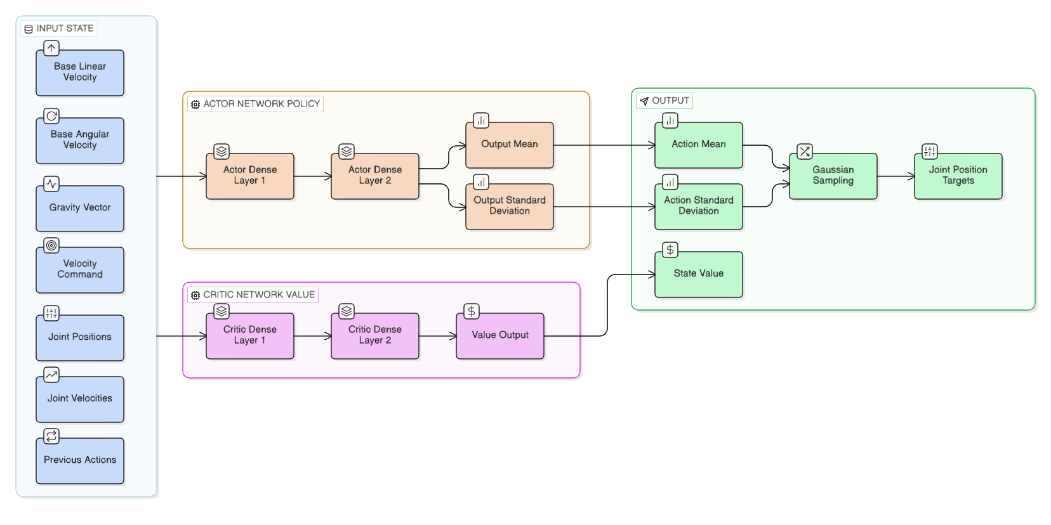
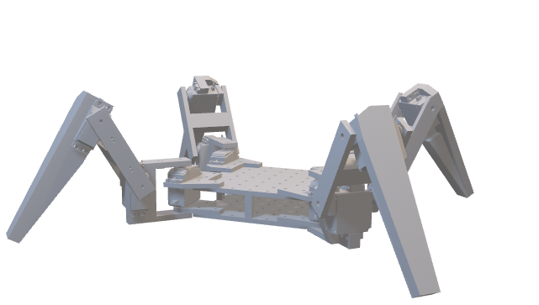
Methodology: Training
Proximal Policy Algorithm Architecture

Slide 16
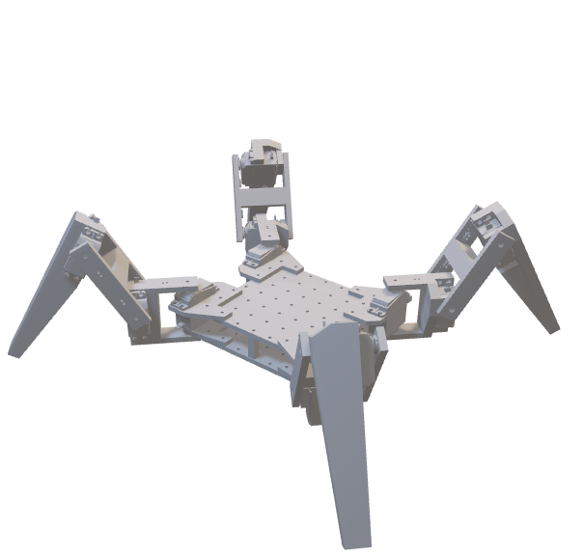
Methodology: Training
Proximal Policy Algorithm Architecture
At each timestep, the robot collects a 48-Dimensional Observation State.
The 48D state is fed into both the Actor and Critic Networks.
The Actor network consists of two fully connected layers with 64 neurons each.
The Actor outputs a 12D action mean vector and a 12D action standard deviation vector.
A Gaussian Distribution is defined for each of the 12 joints.
A 12-dimensional action vector is sampled from the Gaussian Distribution.
The sampled action represents target joint positions.
The target joint positions are passed to a PD controller.
The PD controller computes torque to move the joints​.
The physics engine runs at 200 Hz while the policy runs at 50 Hz.
After the state transition, a reward is computed based on locomotion performance.
The Critic Network (2 × 64 layers) outputs a scalar value.
PPO computes the advantage and updates the Actor using a clipped objective.
The discount factor used is γ=0.99.
The process repeats across 500 parallel environments until convergence.

Slide 17
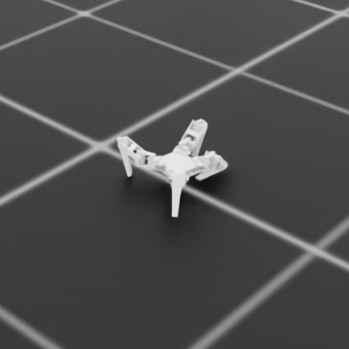
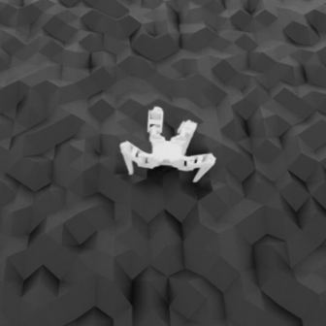
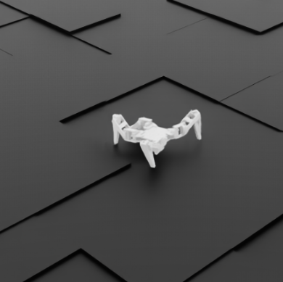
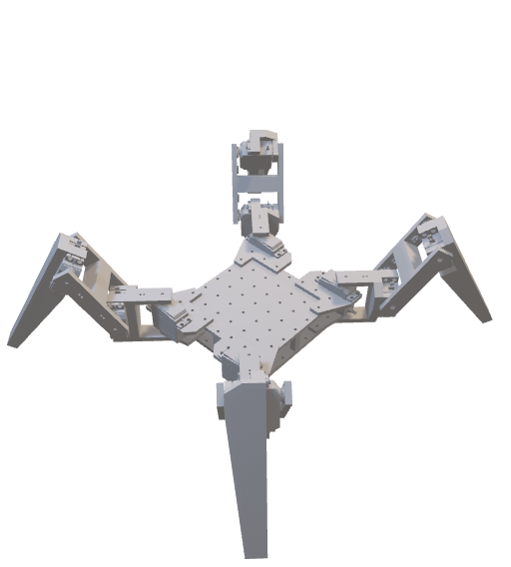
Methodology: Training
Training Robot
Plane Surface
500 Iterations
500 parallel agents
Learn Standing and Walking
Rough Surface
100 Iterations
500 parallel agents
Low Penalties Vertical Motion
Box Surface
100 Iterations
500 parallel agents
Added Base Height Reward

Slide 18
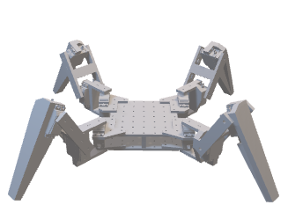
Evaluation
1. Mean Reward vs Total Timesteps
Tracks the average cumulative reward over training to measure overall learning progress and convergence stability.
2. Episode Length vs Total Timesteps
Measures how long the robot survives before termination, indicating improvement in balance and stability over time.
3. Velocity Tracking Performance vs Total Timesteps
Evaluates how accurately the robot matches commanded linear and angular velocities during training.
4. Value Loss Function vs Total Timesteps
Monitors the critic network’s prediction error to assess stability and correctness of value estimation.
5. Noise Standard Deviation (Policy STD)
Tracks exploration level of the Gaussian policy; decreasing STD indicates increased policy confidence.
6. Visual Inspection of Gait Behavior
Qualitative assessment of stepping pattern, smoothness, and stability through simulation playback.

Slide 19
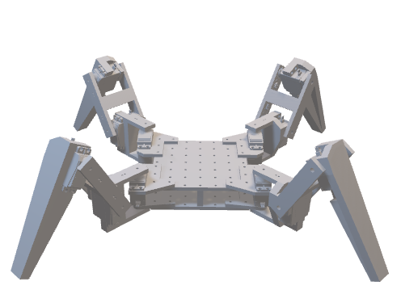
Improvements
Physical Robot Deployment
Advanced Perception Integration
Multi-Terrain Generalization
Develop a fully functional quadruped hardware platform powered by a high-performance edge device for real-world execution.
Develop a fully functional quadruped hardware platform powered by a high-performance edge device for real-world execution.
Develop a fully functional quadruped hardware platform powered by a high-performance edge device for real-world execution.

Slide 20
Challenges
Computational Limitations
Reward Design Complexity
Toolchain Learning Curve
Training Instability
Limited access to high-performance GPUs constrained training speed and experimentation flexibility.
Extensive reward tuning was required to prevent unstable behaviors and reward exploitation.
Early stages involved frequent falling, torque imbalance, and unintended gait patterns before convergence.
Understanding and configuring advanced platforms like Isaac Sim and Isaac Lab required significant adaptation.

Slide 21
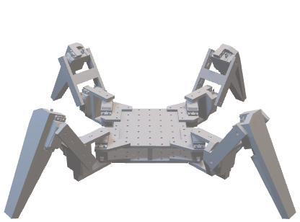
Successful System Development
Stable Multi-Terrain Locomotion
Effective Transfer Learning
Foundation for SAR Robotics
Conclusion
Designed and integrated a complete 12-DOF quadrupedal robot within a high-fidelity simulation framework.
Achieved robust walking performance across flat, rough, and obstacle-based terrains using PPO.
Demonstrated improved training efficiency and adaptation by progressively transferring learned policies across environments.
Established a reliable locomotion backbone that enables future integration of perception, navigation, and real-world deployment.

Slide 22

01
Project
and strategy
You can enter a subtitle here if you need it

Slide 23
Strategy map & balanced scorecard
Perspectives | Strategic objectives
Financial | F1 - insert your own text | F2 - insert your own text | F3 - insert your own text | F4 - insert your own text
Customer | C1 - insert your own text | C2 - insert your own text | C3 - insert your own text | C4 - insert your own text
Internal process | I1 - insert your own text | I2 - insert your own text | I3 - insert your own text | I4 - insert your own text
Learning and growth | L1 - insert your own text | L2 - insert your own text | L3 - insert your own text | L4 - insert your own text

Slide 24
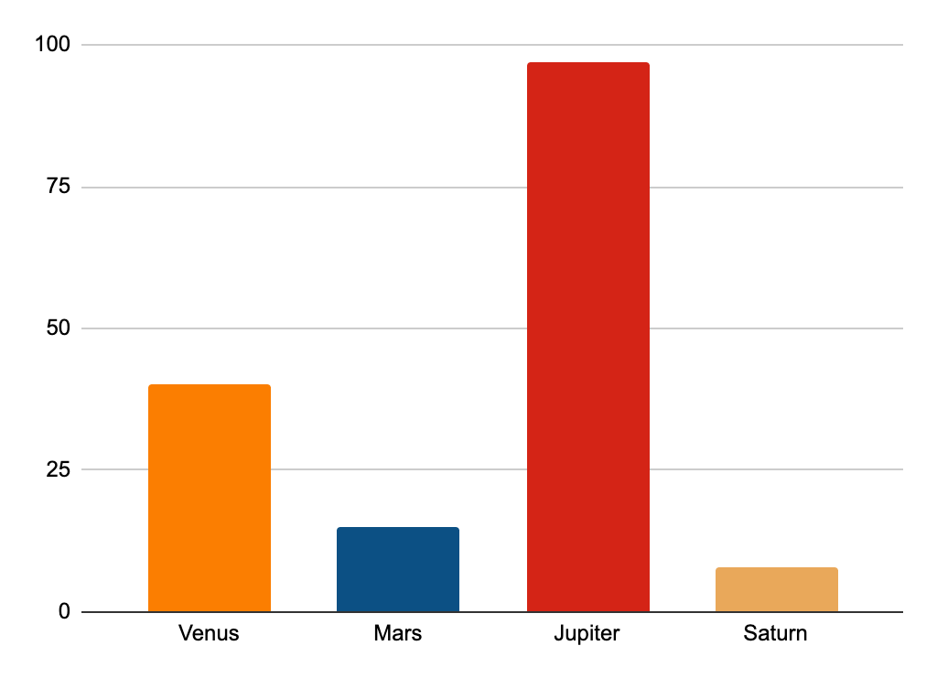
Impact of the risks
5%
20%
Saturn
Venus
Saturn is a gas giant and has several rings
Venus is the second planet from the Sun
45%
30%
Jupiter
Mars
Jupiter is a gas giant and the biggest planet
Despite being red, Mars is actually a cold place
* Follow the link in the graph to modify its data and then paste the new one here. For more info, click here

Slide 25
Awesome words

Slide 26
Financial model
 | Historical results |  |  |  | Forecast period
Inc model | 20xx | 20xx | 20xx | 20xx | 20xx | 20xx | 20xx | 20xx | 20xx
Balance sheet
Assets
Cash | Xx | Xx | Xx | Xx | Xx | Xx | Xx | Xx | Xx
Accounts | Xx | Xx | Xx | Xx | Xx | Xx | Xx | Xx | Xx
Inventory | Xx | Xx | Xx | Xx | Xx | Xx | Xx | Xx | Xx
Current assets | Xx | Xx | Xx | Xx | Xx | Xx | Xx | Xx | Xx
Property | Xx | Xx | Xx | Xx | Xx | Xx | Xx | Xx | Xx
Goodwill | Xx | Xx | Xx | Xx | Xx | Xx | Xx | Xx | Xx
Total | Xx | Xx | Xx | Xx | Xx | Xx | Xx | Xx | Xx

Slide 27
Answers and supporting arguments
How can the company reduce its cost by 10%?
Evaluate cost and service level of potential partners
Design current processes
Select and review current supplier costs
Select non-core functions
Compare current process to best-in-class benchmarks
Evaluate cost of potential alternative suppliers
Choose one partner for each function
Adopt best practices based on benchmarks
Negotiate supplier contracts/choose options
Outsource non-core
functions to save $3 million
Simplify core functions processes to save $1 million
Review supplier cost
to save $1 million
Reduce costs by $5 million through operational improvements

Slide 28
Initiative prioritization matrix
Impact
Effort
An initiative with a high impact would mean one of the following:
The initiative needs to happen in order to achieve the desired future state
The initiative will significantly reduce the cost or increase our revenue
The “effort” criteria is assessed based on the following concepts:
Ease of implementation
Time frame required
Resources required (number of people, capital investment, etc.)

Slide 29
Competitor comparison table
Attributes | Competitor A | Competitor B | My business
Price | $360 | $320 | $300
Quality | Low | Medium | High
Customer age | 20-40 | 18-45 | 18-50
Reputation | Bad | Average | Good
Location | Spain | Italy | USA

Slide 30
Change management strategy & plan
Size of the change
Extreme | Insert name of the change | Insert name of the change | Insert name of the change
High |  |  | Insert name of the change | Insert name of the change | Insert name of the change
Medium |  |  |  | Insert name of the change
Moderate
Low
 | 1 team | 1 business unit | 1 division | Half company | Extreme
Complexity of the change

Slide 31
$489,300
Big numbers catch your audience’s attention

Slide 32
$20,000
$15,000
$10,000
$45,000
Mars is full of iron oxide dust
Venus has a beautiful name
Mercury is the smallest planet
Saturn has several rings

Slide 33
Maturity model
Basic
Standard
Advanced
30%
50%
70%
Mercury is the closest planet to the Sun and the smallest in the Solar System
Venus has a beautiful name and is the second planet from the Sun
Despite being red, Mars is actually a cold place. It’s full of iron oxide dust

Slide 34
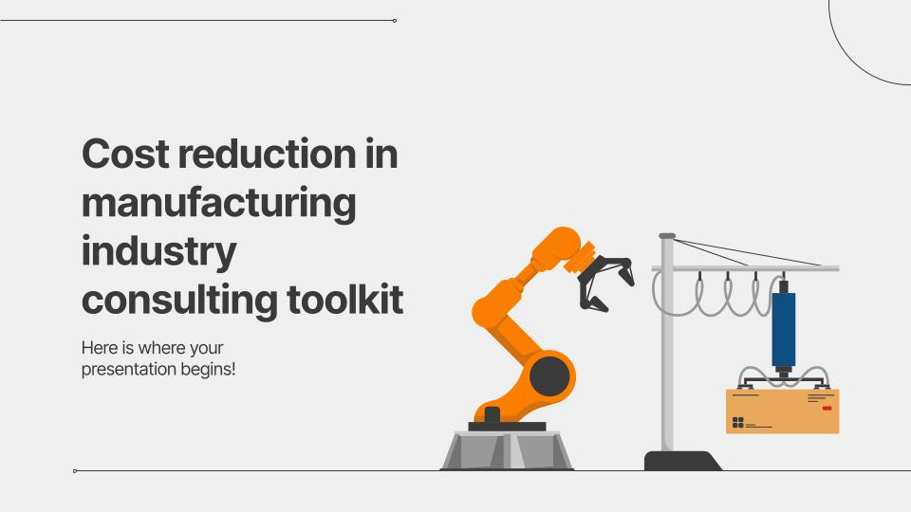
Demo software and app
You can replace the image on the screen with your own work. Just right-click on it and select “replace image”

Slide 35
Alternative Resources
Here’s an assortment of alternative resources whose style fits that of this template:
Vectors:
Automation icons set

Slide 36
Resources
Did you like the resources used in this template? Get them on these websites:
Vectors:
Automation icons set
Photos:
Close-up of a male carpenter working with wood

Slide 37
Thanks!
Any questions?
youremail@freepik.com
+91 620 421 838
yourwebsite.com
Please keep this slide for attribution

